Slide 1
Drug Rehabilitation Research Project
Final
Melanie Andrews and James Wang
Notes:
Hi everyone and welcome again STAND. This is week 11 of our Sprint projects, and my name is Melanie and I’m going to be speaking on behalf of my team today: myself, Neethu, Saurabh, and James.

Slide 2


Agenda
National Client Breakdown
TEDS Treatment Completion Drivers
Racial Disparity Treatment Completion

Slide 3
Clients at The National Level
Race
67% White
17% African American
Age
Average Age: 36
Half of the clients fall between the ages 27- 47
Education
Half of the clients have graduated from high school
Marital status
65% Single
13% Married
21% Divorced /Separated

Slide 4
TEDS Rehabilitation Completion Drivers
Positive
Labor Force Participation
Clients that are employed or trying to find employment
Have higher odds of completing treatment
Institutional /Community Treatment Referal
Clients that are referred by communities or institutions
Have higher odds of completing treatment
Independent Living
Have lower odds of completing treatment
Drug Dependency
Clients diagnosed with a drug dependency
Have lower odds of completing treatment
Clients that don't have a supervised living situation
Negative

Slide 5
Racial Disparity Treatment Drivers
Substance Induced Disorder
Daily Substance Use
Daily substance use increases racial disparities for treatment completion
Heroin Usage flagged at Intake
Usage of heroin increases racial disparities for treatment completion
Diagnosed substance induced disorders increase racial disparities for treatment completion
Increased
School / Educational Referral
Being referred by a school or educational institution reduced racial disparities for treatment completion
Services Received
Different services such as ambulatory, 24-hour detoxes, long term stays reduced racial disparities for treatment completion
Employment
Being employed full time or part time reduced racial disparities for treatment completion
Reduced

Slide 6
Appendix

Slide 7
TEDS Model Slides

Slide 8
Let’s Recap our Logistic Regression
TEDS data significant variables:
The major drivers of whether a TEDS client successfully completes treatment is based off the services received, employment status, and clinical diagnosis
Although age and gender are significant, they have very little impact on determining whether a patient is likely to complete treatment.
Being referred by court systems, communities, and educational establishments positively influence treatment completion
Participating in the labor force or being willing to participate in the labor force positively influences treatment completion
Compared with dependent living, being homeless or living independently negatively influence successful treatment.
Notes:
We ran a Logistic Regression on TEDS and had some takeaways we wanted to recap and dive deep into the coefficients. We looked at the statistical significance of TEDS factors again, but also really looked into every coefficient.

Slide 9
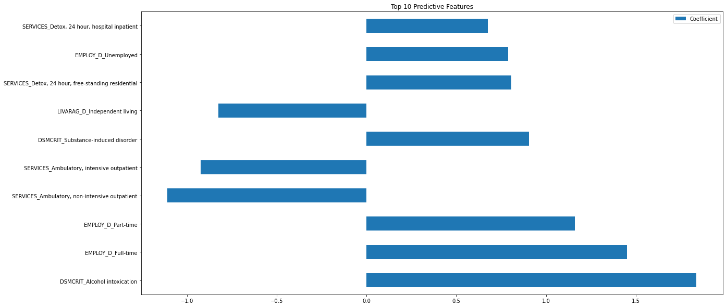
Let’s Recap our Logistic Regressions
Notes:
We ran a Logistic Regression on TEDS and these were the top 10 significant variables in terms of the coefficients. These features are what most drove the rate of the logistic regression to increase.
#see comment

Slide 10
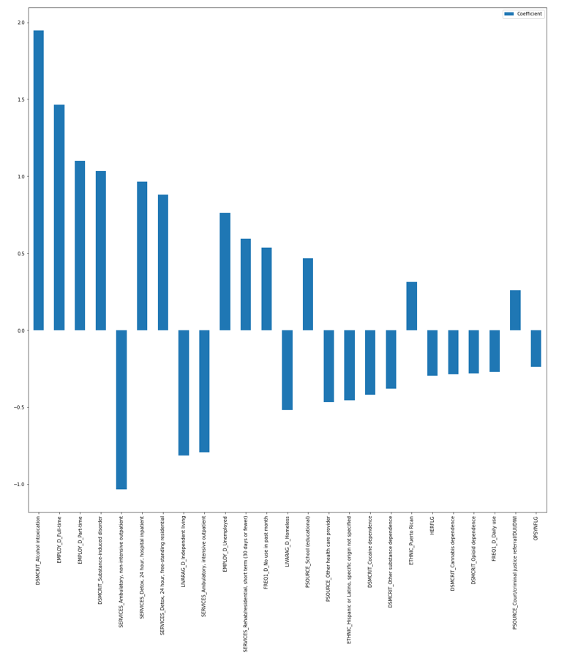
Logistic Regression Top 20

Slide 11

Why Virtual Twins Analysis
Virtual Twins (VT) Analysis allows us to look at factors that intersect with race (our variable of interest) and influence differences (if they exist) in probability of completing treatment
Kong Y, Zhou J, Zheng Z, Amaro H, Guerrero EG. Using machine learning to advance disparities research: Subgroup analyses of access to opioid treatment. Health Serv Res. 2021 Oct 17. doi: 10.1111/1475-6773.13896. Epub ahead of print. PMID: 34657287.
Notes:
-If we want to see the gaps of why exactly certain races are successfully completing treatment vs those who aren’t, we need to find what is statistically significantly driving the difference in the likelihood of one race completing the
-In stand, we know that a huge population of our clients are African American and black. If we can see in the TEDS what drives this different in successfully completing treatment for African Americans or not African Americans, then maybe we can taylor our program here at STAND to this difference. Maybe we can pick out which factors are particularly this barrier for African Americans and try honing in on them to improve treatment outcomes

Slide 12
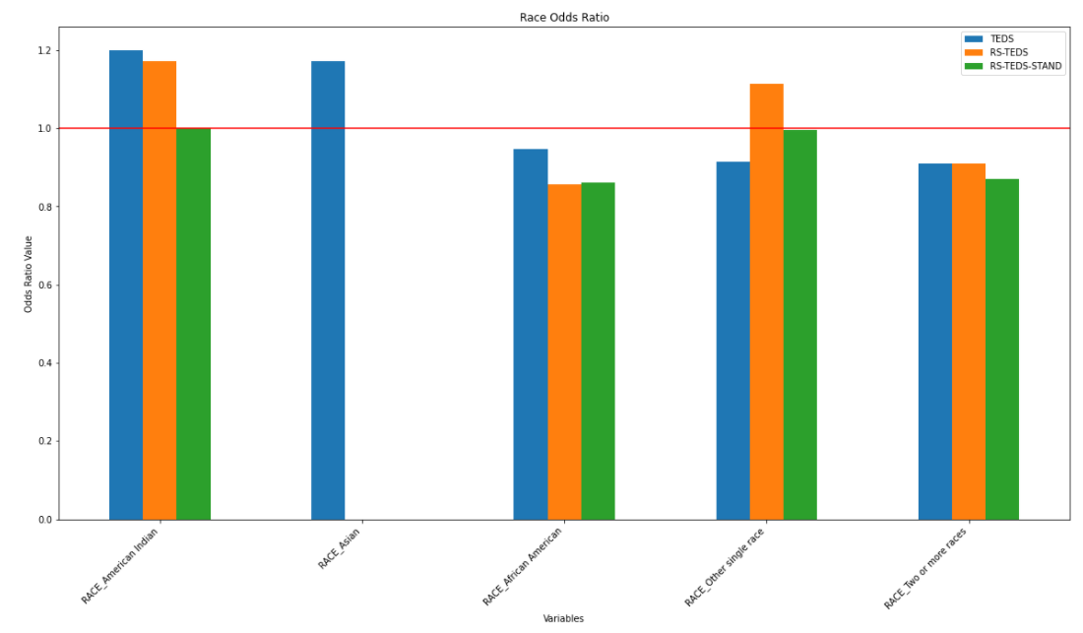
TEDS Data: Race
Compared against White patients
African American and Bi-racial patients have lower odds of successfully completing treatment compared to White patients
In the overall population, American Indians and Asians have higher odds of completing treatment
Notes:
#only reason I added this slide in, is that I think one of the main thing we wanted to give an overall picture of teds race comparison before talking about the disparities that we see in VT

Slide 13
Virtual Twin Analysis Continued
In our case, wanted to look ask:
Given a client/patient is African American (and all other x variables are as is), what is the probability of each client completing treatment?
Given a client/patient is not African American (and all other x variables are as is), what is the probability of each completing treatment?
If there is a difference in these probabilities, what factors drive this difference??

Slide 14
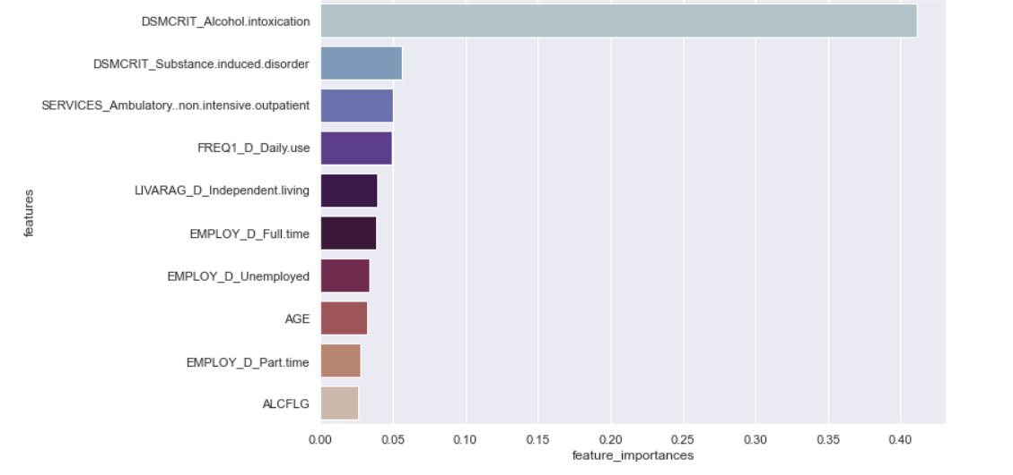
Feature Importance For Probability Difference
What feature were “most important” for influencing this probability difference?
Notes:
Alcohol intoxication, largest feature
Followed by substance induced disorder
Whether someone received non intensive outpatient service
Frequency of how much they were using at discharge
Their employment status at discharge
Alcohol flagged at admission
We don’t know the directionality here, but we would like to run a multilinear regression or logistic regression using this probability difference to see the difference in

Slide 15
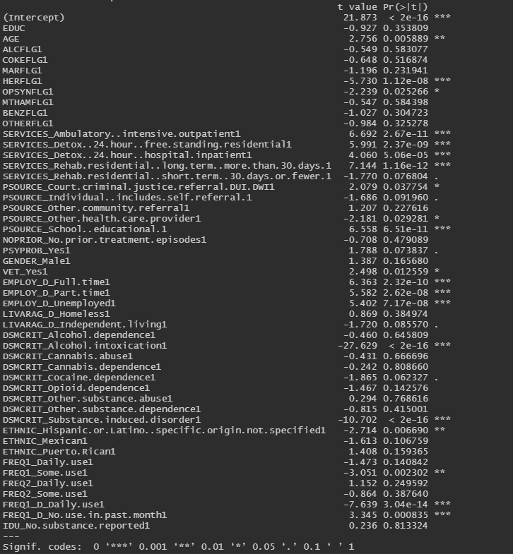

Multiple Linear Regression-Analysis
~56% of the difference in rehab completion between African American patients and non-African American patients can be explained by x axis variables

Slide 16
Virtual Twins Analysis- Multilinear Regression
What factors reduce the disparity between African American rehab completion and other race rehab completion?
What factors increase the disparity between African American rehab completion and other race rehab completion?
Top Positive Coefficients:
If they were referred from a school/education primary source
Type of services received such as 24-hour detox, ambulatory services, long term stay
Whether they are employed part time or full time
Top Negative Coefficients:
Alcohol intoxication (DSMCRIT)
Substance induced disorder (DSMCRIT)
Daily use of substances at discharge
Cocaine dependence disorder (DSMCRIT)
Heroin flagged at intake

Slide 17
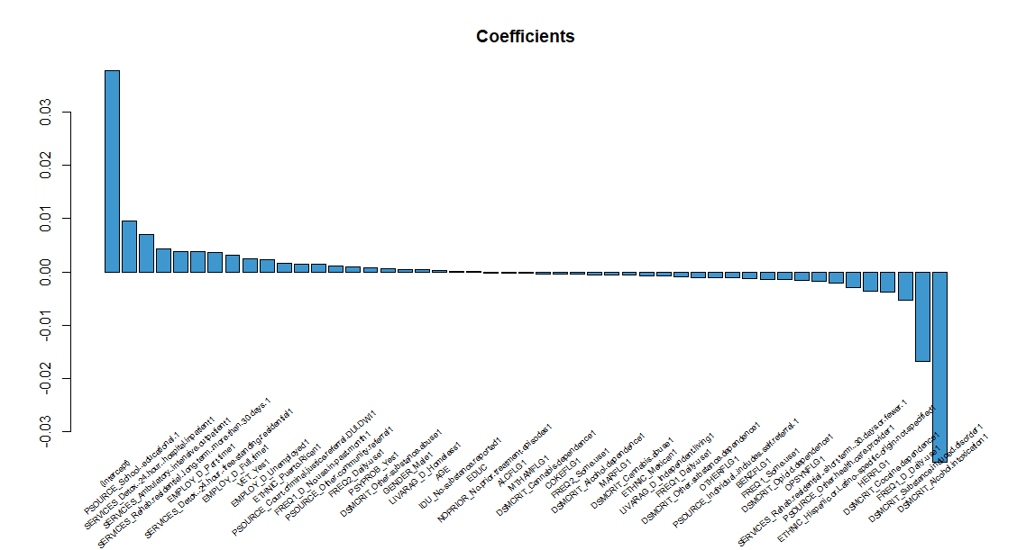
Coefficients-Virtual Twins Multilinear Regression

Slide 18
TEDS ANALYSIS

Slide 19
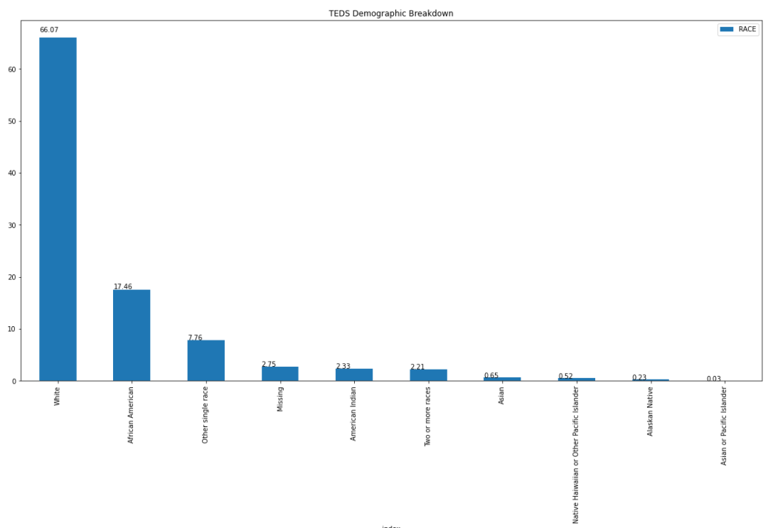
TEDS Race Breakdown
TEDS Race breakdown is comparable to the U.S population breakdown

Slide 20
Exploratory Data Analysis(EDA)
As we can see from the chart, more than 1.4 million people attended self groups during the program.
Next steps include, finding correlation between people who have attended self help groups and completed treatment successfully.

Slide 21
Exploratory Data Analysis(EDA)

Slide 22
Exploratory Data Analysis(EDA)
Data shows that most of the clients belong to the 25-34 age range. Closely followed by 35-39 year range.

Slide 23
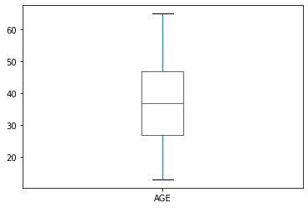
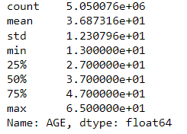
TEDS Age

Slide 24
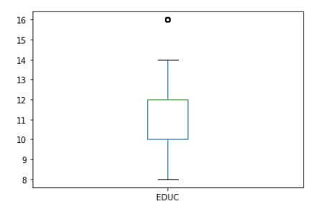
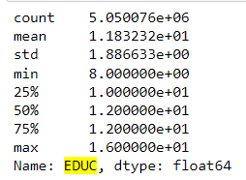
TEDS EDUC

Slide 25
Exploratory Data Analysis(EDA)
Days in program show that around 50% people have been discharged (with/against medical advice) within 30 days of start of program.

Slide 26
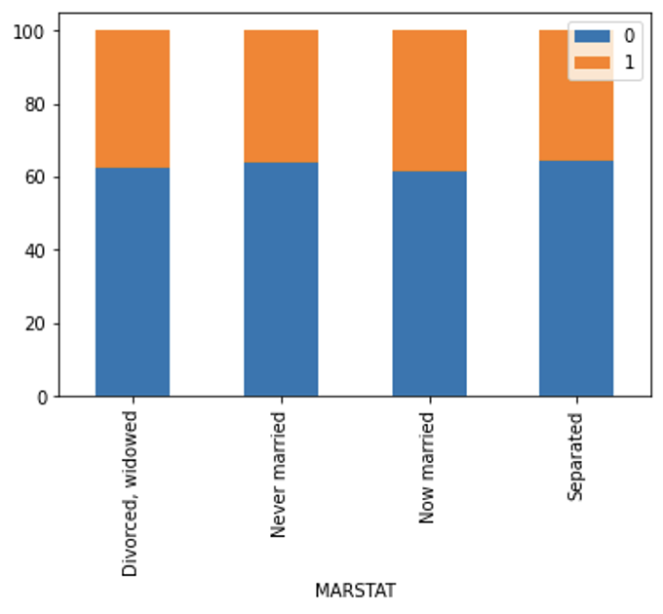
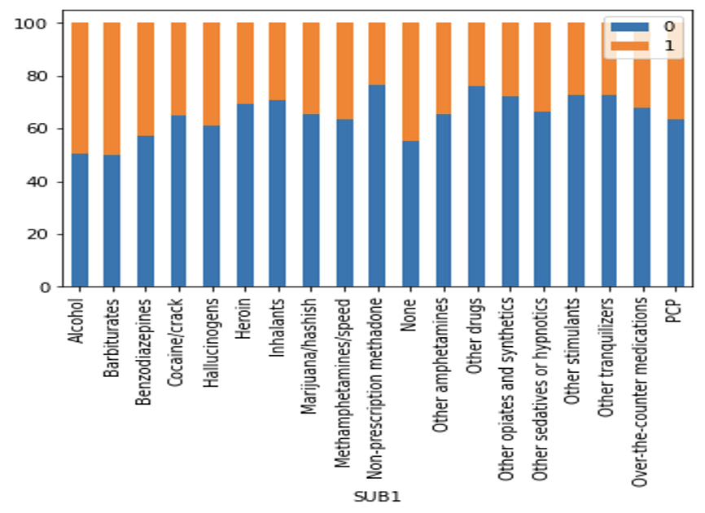
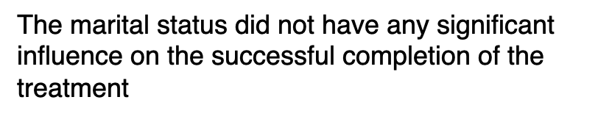
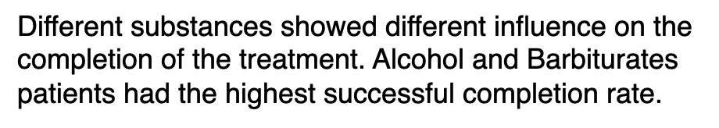
Resampled TEDS Data

Slide 27
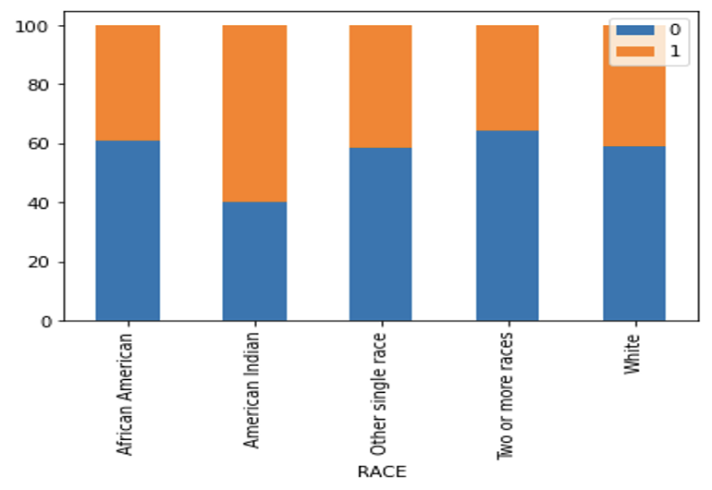
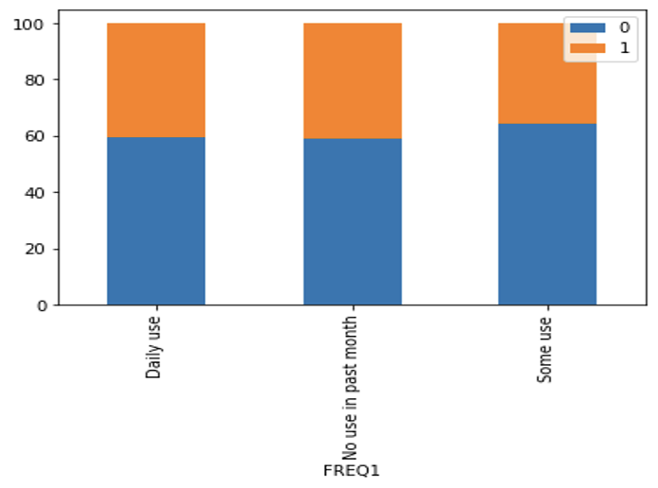
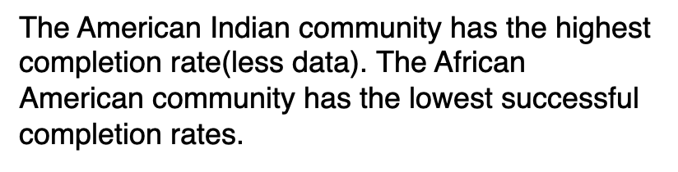
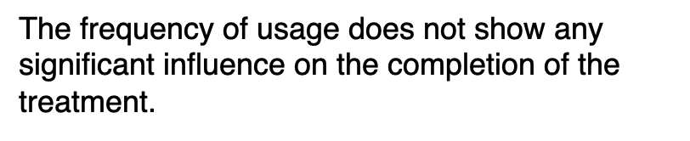
Resampled TEDS Data

Slide 28
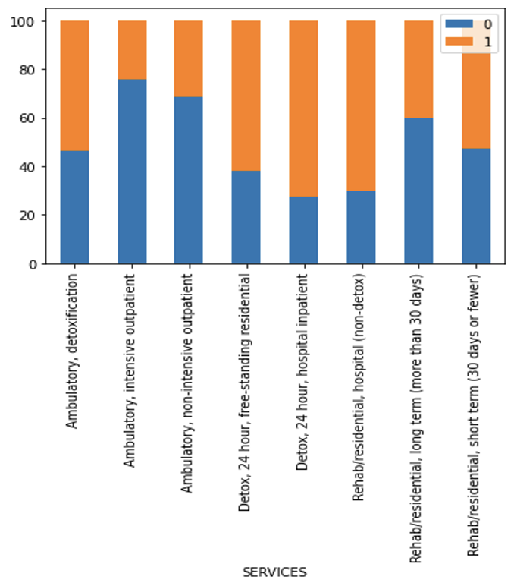
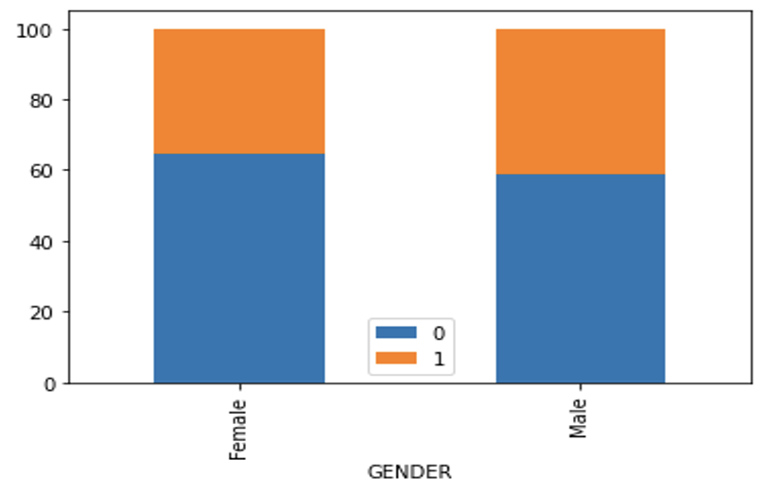
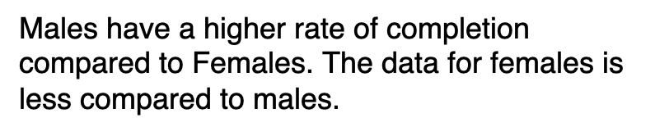
Resampled TEDS Data

Slide 29
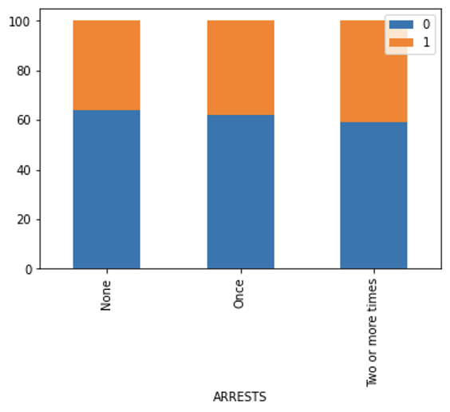
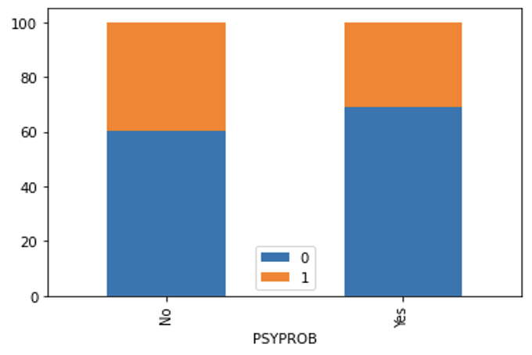

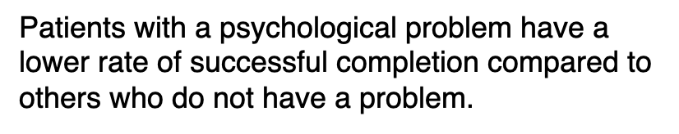
Resampled TEDS Data

